Slide 1
NRI Diploma in Economic Policy Analysis
Policy for REDD
___________________________________________
Cash for carbon:
hot prospect or hot air?
Colin Hunt
Visiting Fellow in Economics
The University of Queensland
c.hunt3@uq.edu.au

Slide 2
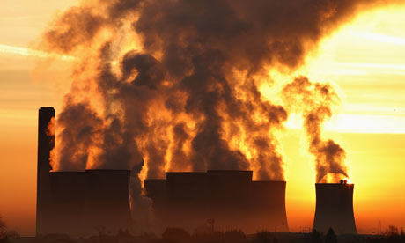
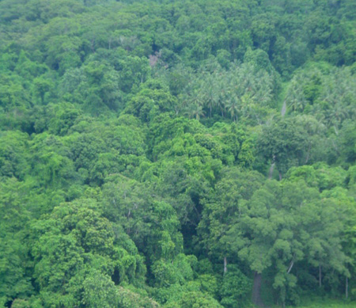
Market failure
Emissions of C at no cost
Conservation of C no benefit

Slide 3
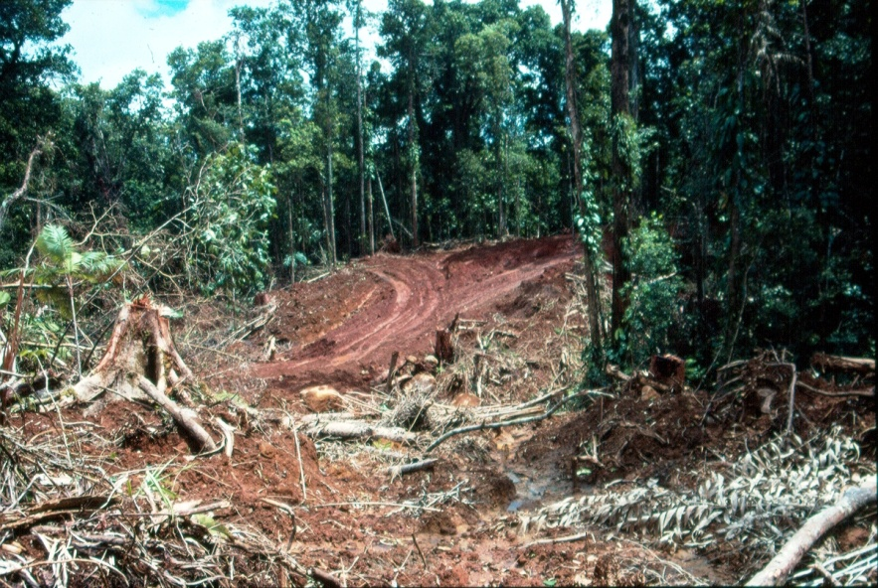
REDD and REDD plus
REDD
Reduction in deforestation and forest degradation
REDD++
Low impact logging, enrichment planting,
etc.
Notes:
Source; 1. caaltd.org
2. rainforestportal.org

Slide 4
Global greenhouse gas sources
Notes:
Source: World Resources Institute, CAIT 2008 version, GHG emissions by sector 2005, http://cait.wri.org, accessed 14 April 2011

Slide 5
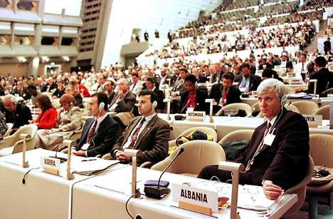
Kyoto 1997l

Slide 6
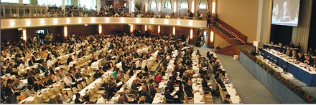
Bonn, 2005

Slide 7
Coalition of rainforest nations, 2005

Slide 8
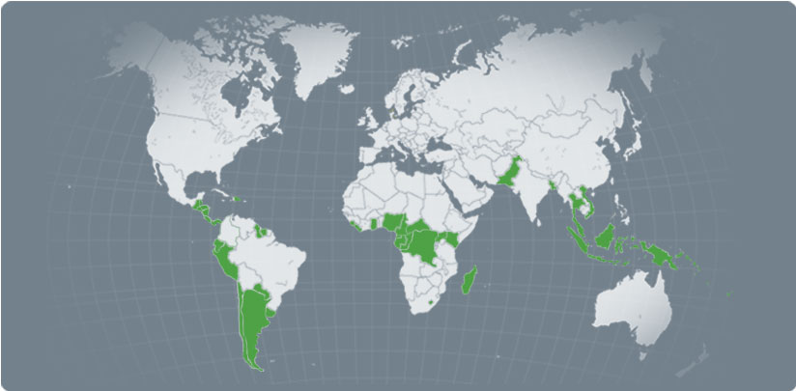
Coalition of rainforest nations

Slide 9
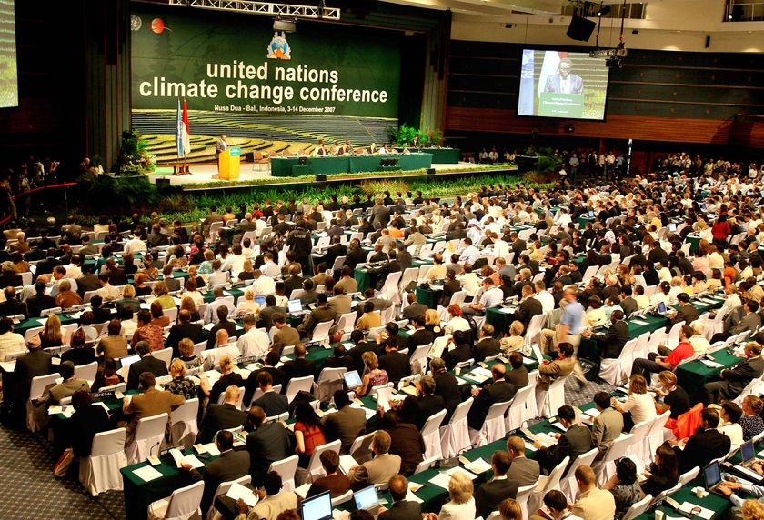
Bali 2007

Slide 10
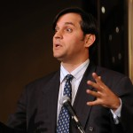
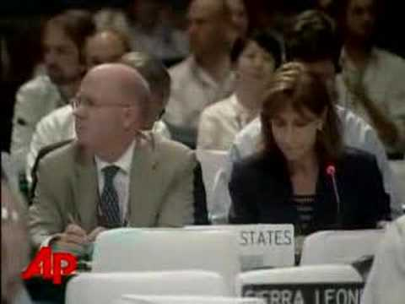
“If the US is not willing to lead then get out of the way!”
Paula Dobriansky
Kevin Conrad

Slide 11
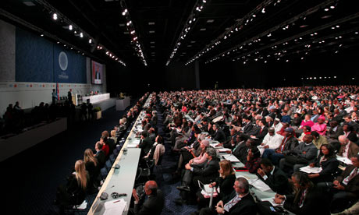
Copenhagen 2009
Notes:
transitionwestmarin.wordpress.com

Slide 12
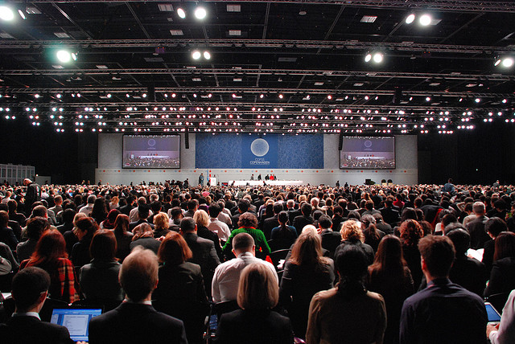
Cancun 2010

Slide 13
PNG’s UNFCCC post-Copenhagen submission
2 February 2010
1. Increase GDP per capita more than 3 times by 2030
2. Decrease GHG emissions at least 50% before 2030
Notes:
See:
Filer, C. 2010. The impacts of rural industry on the native forests of Papua New Guinea, Pacific Economic Bulletin, 25(1), 135-153.
See Hunt, C. 2010. Compensating for the costs of reducing deforestation in Papua New Guinea, Pacific Economic Bulletin, 25(1), 64-88.

Slide 14
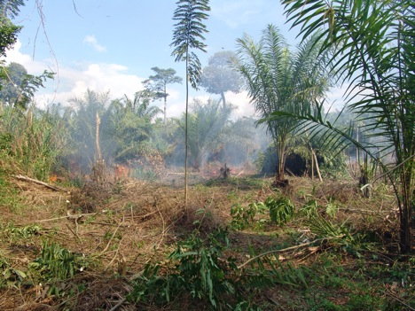
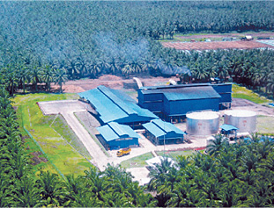
What about REDD for other land uses in PNG?

Slide 15
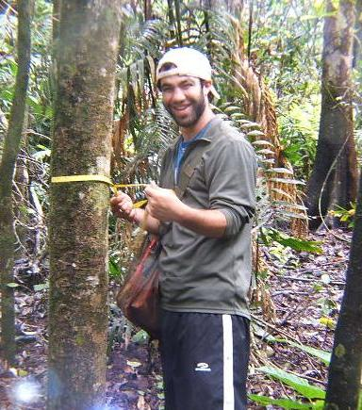
How much carbon in forests?
Ground-truthing
Notes:
See: Fox et al. (2011).

Slide 16
PNG logging 175,000 ha a year
137 Tonnes C per ha
62 tonnes C per ha

Slide 17
Carbon markets
1 tonne C = 3.67 tonnes of CO₂

Slide 18
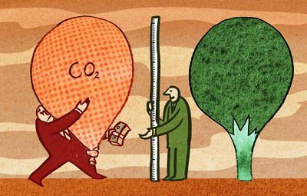
Markets and ‘mani long win’

Slide 19
Opportunity cost of REDD
Logging companies (profits)
The government (log export tax)
Landowners (royalties and development benefits)

Slide 20
1. Global (UNFCCC) market for C
Demand for C because of caps
buyers and sellers of C
MRV C $
landowners

Slide 21
2. Voluntary market for C
Voluntary demand for C offsets
C $
carbon cowboys
MRV? C $
landowners

Slide 22
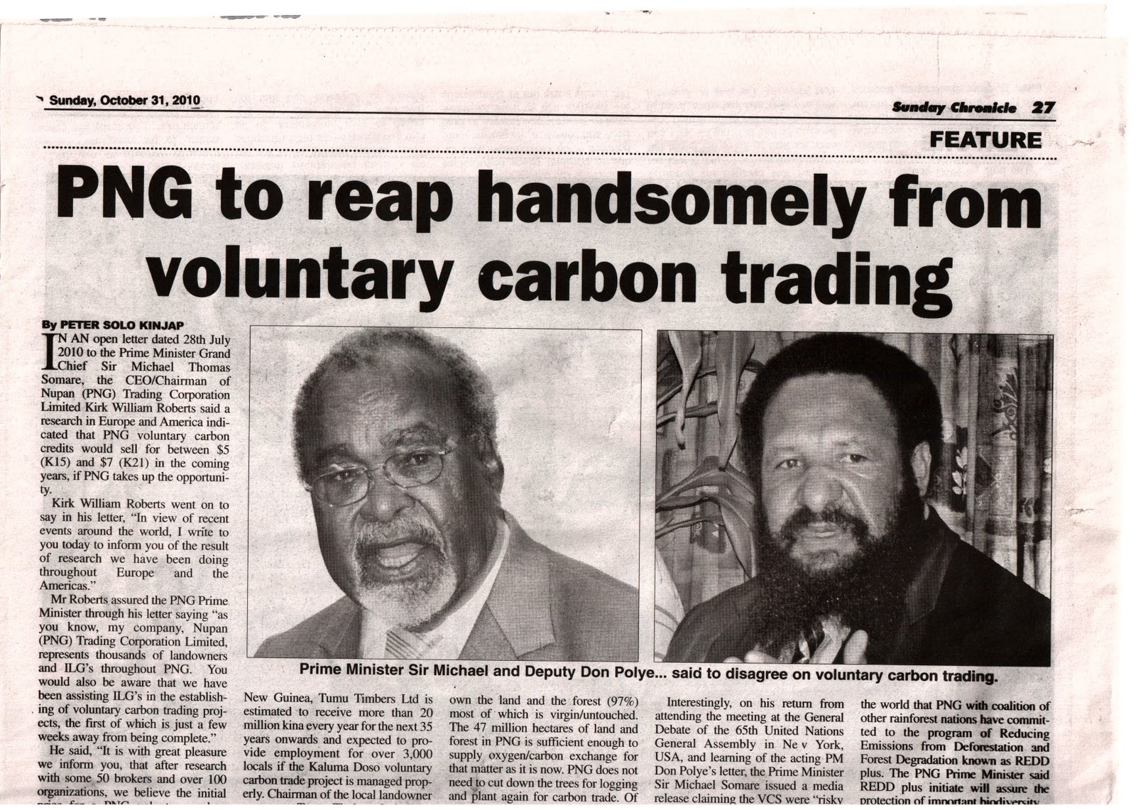
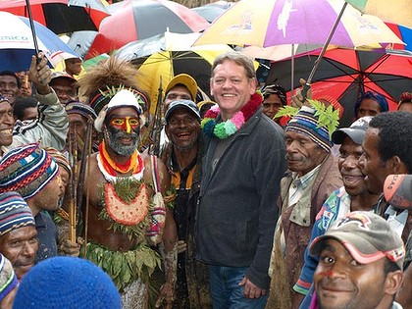
Carbon Cowboy
“I am a top foreigner in Papua New Guinea, says carbon kingpin”,
Notes:
Quote: Ben Cubby and Marian Wilkinson, SMH, September 4, 2009 .

Slide 23
3. Donor
$
PNG government
MRV C $
landowners

Slide 24
Is a tonne of CO₂ a tonne of CO₂?

Slide 25
Measurement
Leakage
Permanence

Slide 26
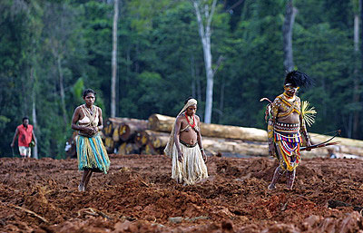
Would the forest have been cleared or logged?
?

Slide 27
REDD plus in PNG
Low impact logging and
Logging Code of Practice
REDD Plus = CO₂ LCP - CO₂ LIL
A

Slide 28
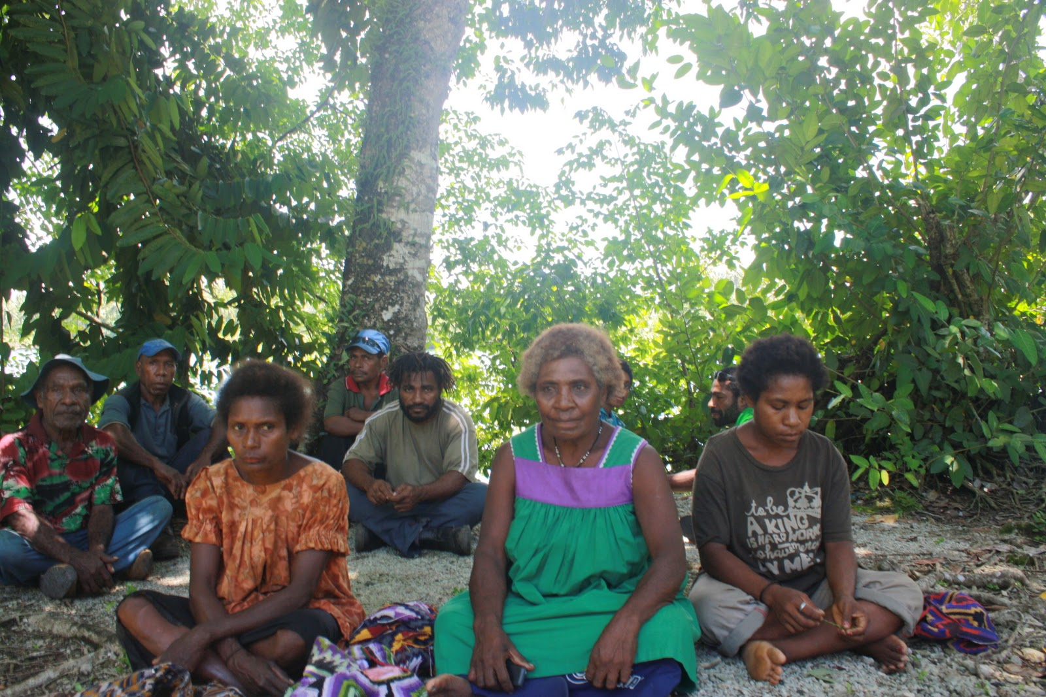
REDD and PNG livelihoods

Slide 29
Donor
$
PNG government
MRV C $
landowners

Slide 30
Some key words
REDD and REDD plus
Ground-truthing
MRV
CO₂ and carbon markets
Voluntary market
Donor
Leakage

